Slide 1
ENGINEERING CHEMISTRY - II
22CH203
Unit 5 – Lesson Plan 1

Slide 2
CHARACTERISTICS OF A CHEMICAL REACTION
Rearrangement of outer electrons
No new elements are formed. New compounds are produced by rearrangement of elements.
Small amount of energy is released (Exothermic) or absorbed (Endothermic)
Rate of the reaction depends on concentration and external factors like temperature, pressure and catalyst.

Slide 3
CHARACTERISTICS OF A NUCLEAR REACTION
Change in composition of nucleus.
New elements are formed.
Huge amount of energy is released or absorbed.
Rate of the reaction does not depend on concentration and external factors like temperature, pressure and catalyst.

Slide 4
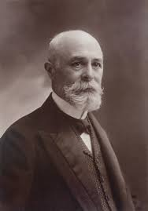
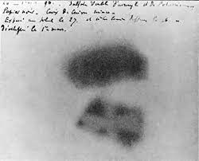
RADIOACTIVITY
In 1896, Henry Becquerel found that atoms could be radioactive.
Henry Becquerel
Image on photographic plate due to radioactive emission from uranium

Slide 5
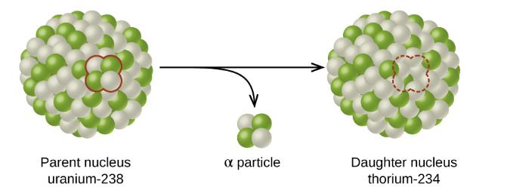
RADIOACTIVE DECAY
The spontaneous change of an unstable nuclide into another is radioactive decay.
Example:
The alpha particle removes two protons (green) and two neutrons (gray) from the uranium-238 nucleus

Slide 6
ISOTOPES
The term “isotope” mainly refers to the variation in the atomic mass or weight of an element.
It is also defined as variants of a particular element where these variants will have the same number of protons but differ in the number of neutrons in the atom.

Slide 7
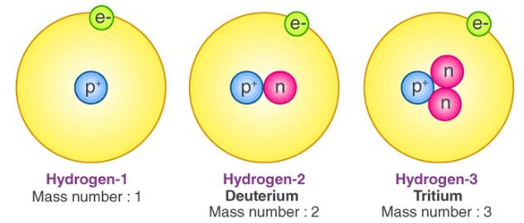
ISOTOPES - HYDROGEN
Abundance 99.98%
Number of neutrons = Mass number – atomic number (number of protons)

Slide 8
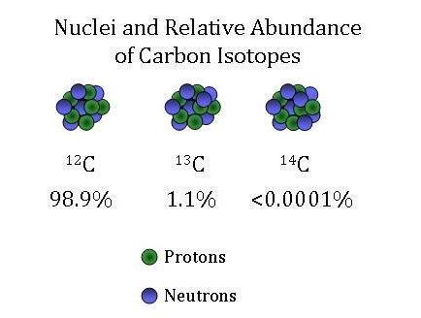
ISOTOPES - CARBON

Slide 9
ISOTOPES
Tin has 22 isotopes,
Zinc has 21 known isotopes
Neon is a mix of 3 isotopes
Natural xenon consists of a mixture of 9 stable isotopes and
Nickel has 14 known isotopes

Slide 10

ENERGY RELEASED IN NUCLEAR REACTIONS
Energy released in a nuclear reaction is equal to the mass loss during the reaction (E=mc²).
Total mass of reactant =8.1678 and of product = 8.0052.
Mass lost =0.1626 amu

Slide 11
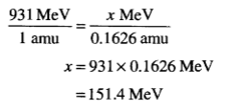
ENERGY RELEASED IN NUCLEAR REACTIONS
Mass lost =0.1626 amu
Energy release for the mass loss of 0.1626 amu:

Slide 12
MASS DEFECT (∆M)
Mass defect may be defined as the difference between the mass of an atom and sum of the free masses of its protons and neutrons (collectively known as nucleons).

Slide 13
MASS DEFECT (∆M) - HELIUM
The mass defect of helium atom having two protons (mass of one proton = 1.00815 amu) and two neutrons (mass of one neutron = 1.00899 amu) with the measured mass of 4.0026 is calculated as follows:
Total expected mass of helium = 2 x 1.00815 + 2 x 1.00899
= 2.0163 + 2.01798
= 4.03428 amu.

Slide 14
BINDING ENERGY
The binding energy is a measure of the force that holds the nucleons (protons and neutrons) together.
The energy that binds the nucleons together in a nucleus is called the binding energy.
The binding energy is usually expressed in terms of million electron volts (MeV).
In other words, energy equal to binding energy will be needed to break up the nucleus into its constituent nucleons.
Consequently, the greater is the binding energy, the more stable is the nucleus

Slide 15
BINDING ENERGY
Binding energy is the energy equivalent to the mass defect. Mathematically, the binding energy (E_{B}) and the mass defect (∆m) are related as follows:
E_{B} = ∆m x 931 Mev

Slide 16

BINDING ENERGY
Binding energy per nucleon can be calculated by dividing the total binding energy by the sum of the number of protons and neutrons present in a nucleus, i.e.

Slide 17
THE BINDING ENERGY AND THE STABILITY OF THE NUCLEUS
The greater the binding energy per nucleon, the more stable is the nucleus. Thus the nuclei of mass number 60 having maximum energy per nucleon are more stable, e.g.⁵⁶Fe.
The nuclei that are heavier and lighter than this have lower binding energies per nucleon and are less stable.
Thus ²³⁵U undergoes fission to give lighter and more stable isotopes such as ¹³⁹Ba and ⁹⁴Kr with the release of energy.
Similarly, two or more lighter nuclei (²H, ¹H) with lower binding energy per nucleon combine together to give a heavier and more stable nucleus with the release of energy.

Slide 18
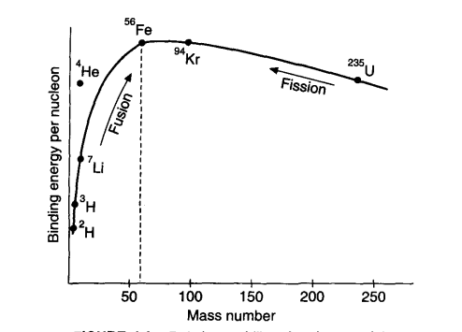
THE BINDING ENERGY AND THE STABILITY OF THE NUCLEUS

